Slide 1
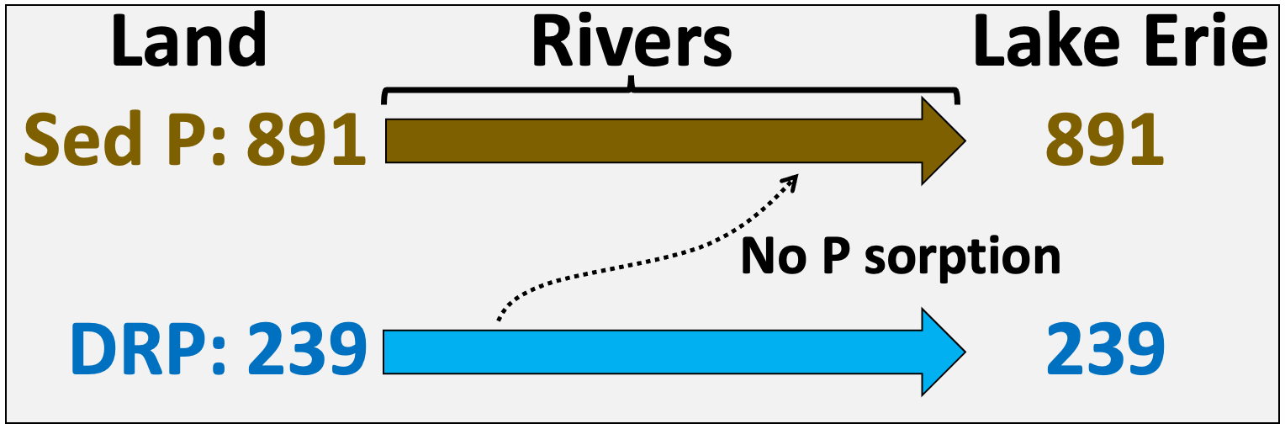
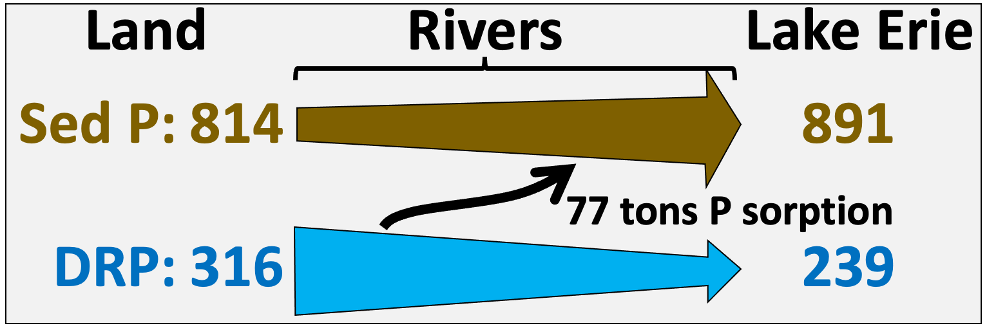
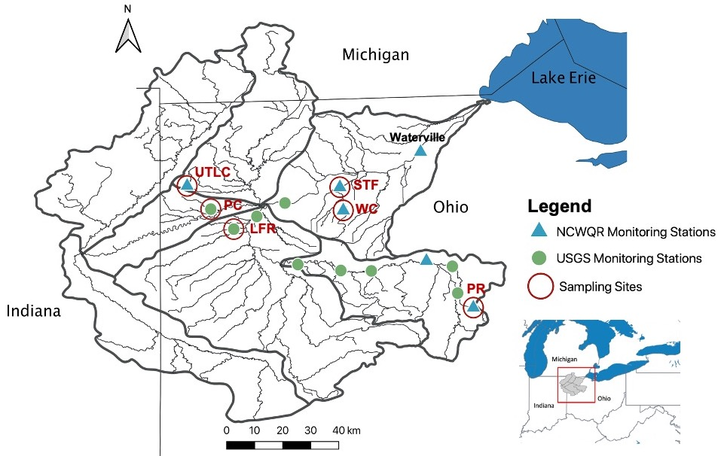
a)
b)
c)

Slide 2
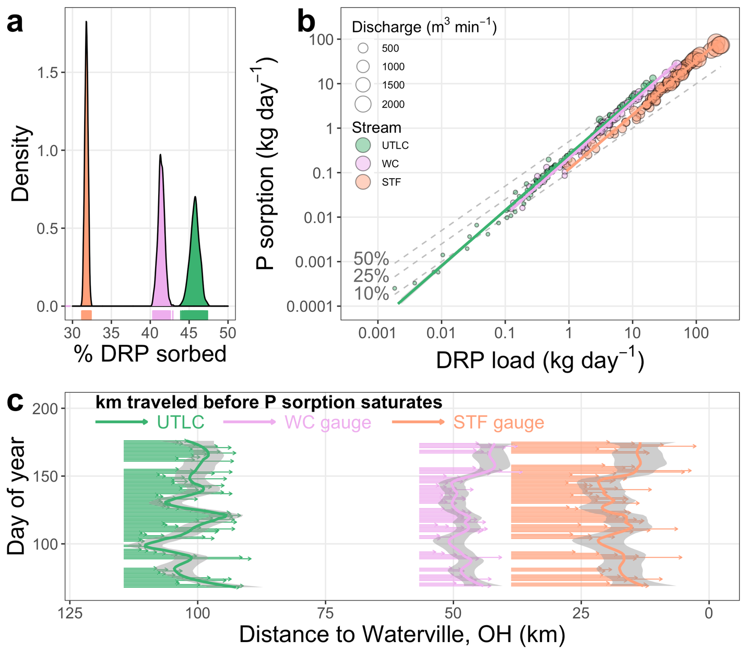

Slide 3
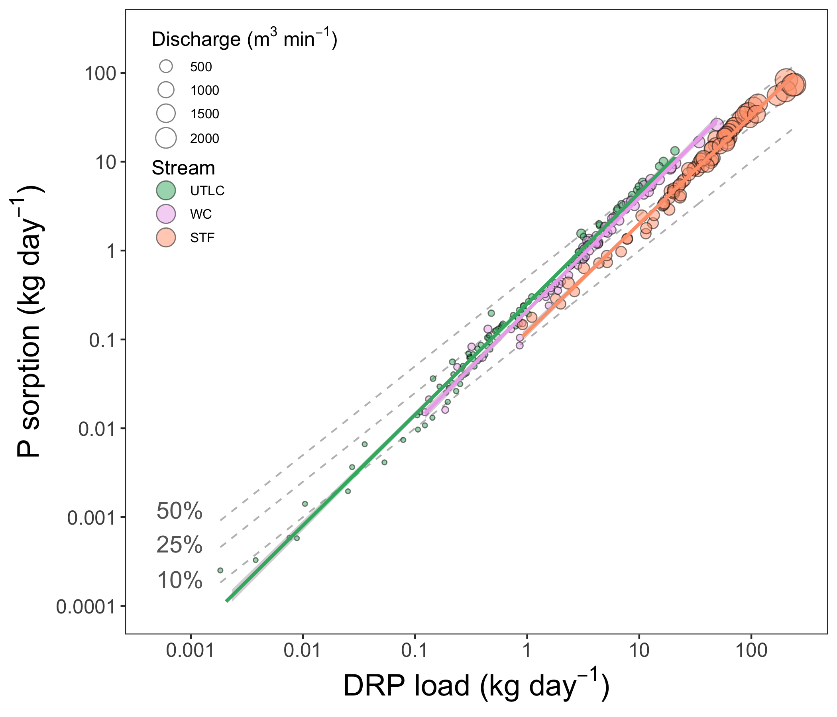
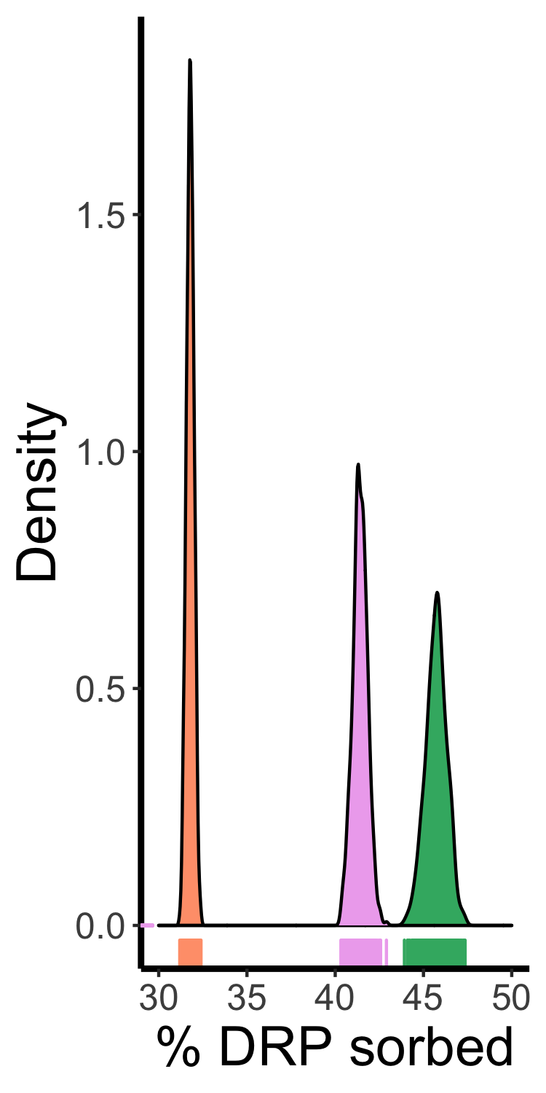

Slide 5
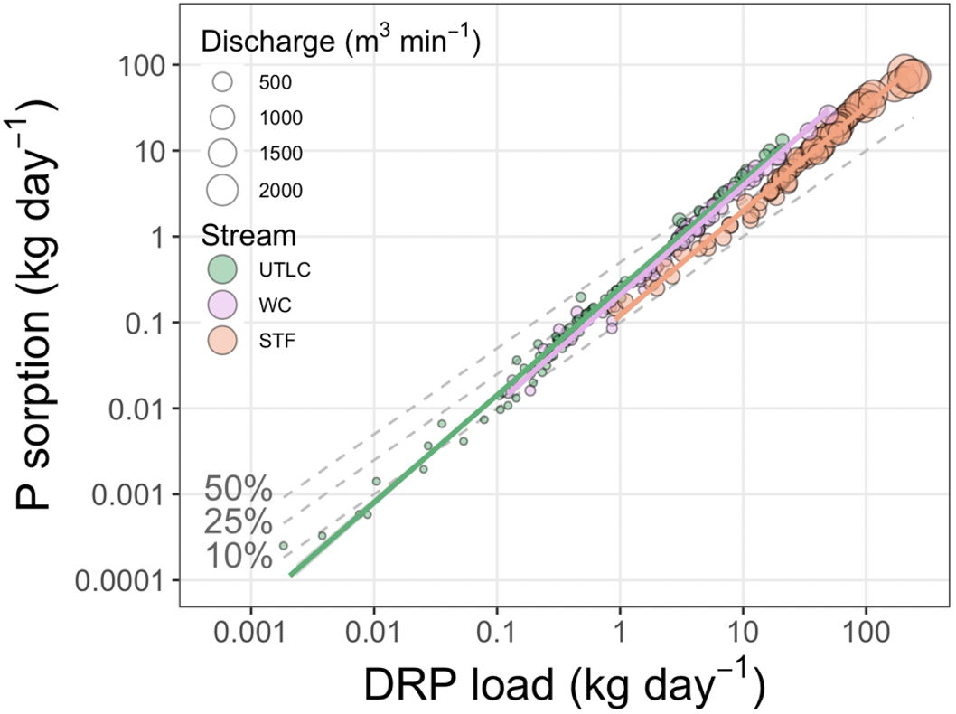

Slide 6
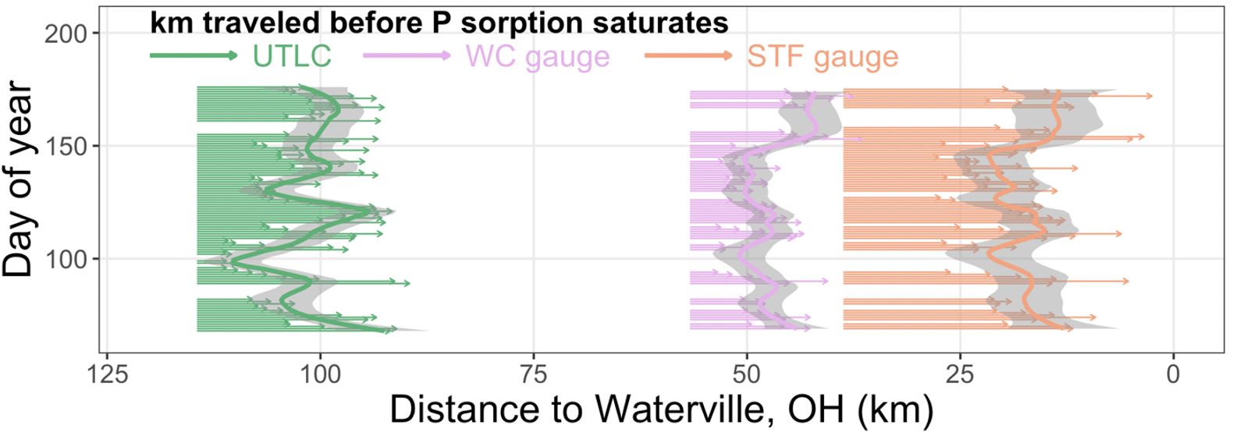

Slide 7
a)
Land
Rivers
Lake Erie
Sed P:
891
891
No P sorption
DRP:
239
239
b)
Land
Rivers
Lake Erie
Sed P:
814
891
77 tons P sorption
DRP:
316
239

Slide 8
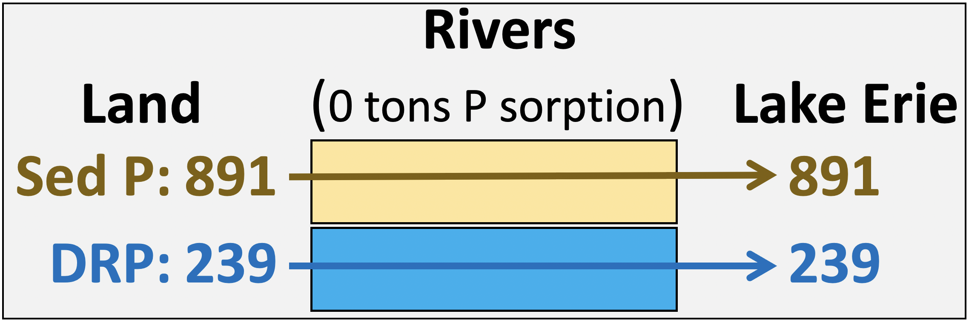
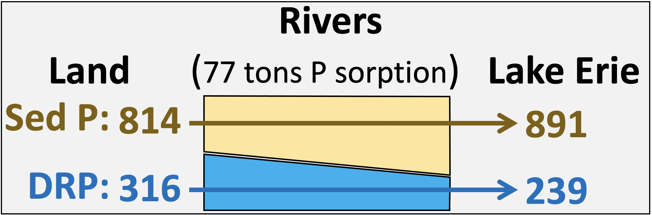
a)
b)
c)

Slide 9
Rivers
(0 tons P sorption)
Land
Lake Erie
Sed P:
891
891
DRP:
239
239
Rivers
(77 tons P sorption)
Land
Lake Erie
Sed P:
814
891
DRP:
316
239

Slide 10
a)
Rivers
(0 tons P sorption)
Land
Lake Erie
Sediment P:
891
891
DRP:
239
239
b)
Rivers
(77 tons P sorption)
Land
Lake Erie
Sediment P:
814
891
DRP:
316
239

Slide 11
a)
Land
0
Lake Erie
DRP
Sediment P
239
239
Streams & Rivers
891
891
b)
Land
77
Lake Erie
DRP
Sediment P
316
239
Streams & Rivers
891
814
Notes:
All P is g e8
All post 2003 means
obs
PP is TP-DRP = 11.3 - 2.4
w/o sorp
PP is TP-DRP = 11.3 – 3.0

Slide 12
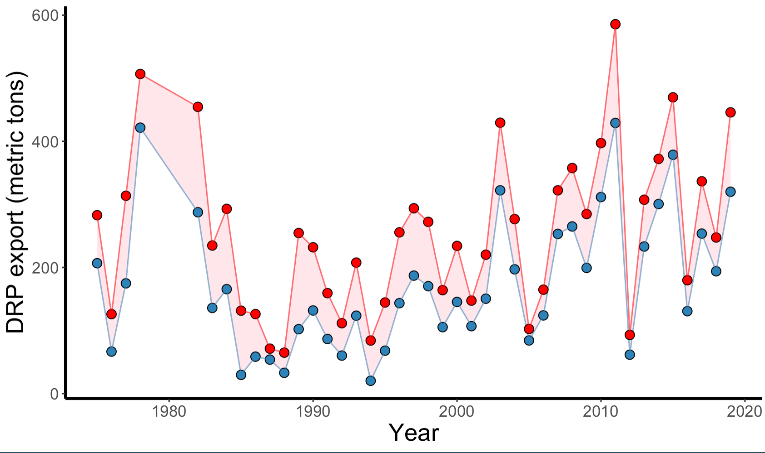
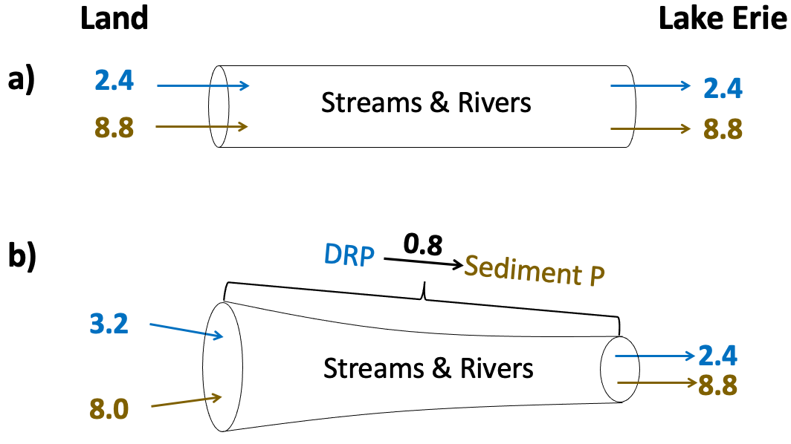
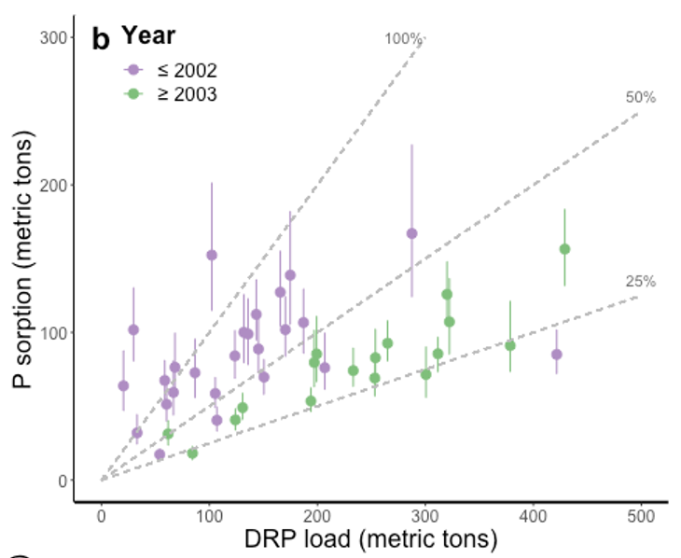
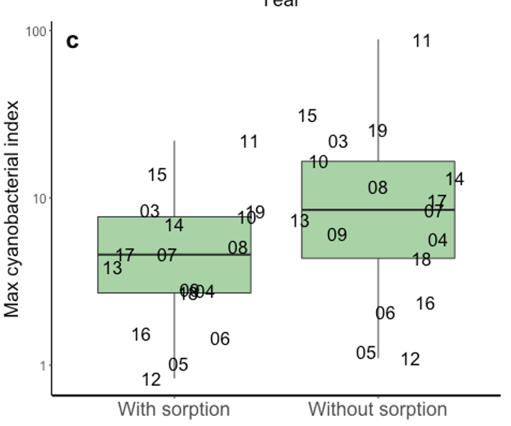
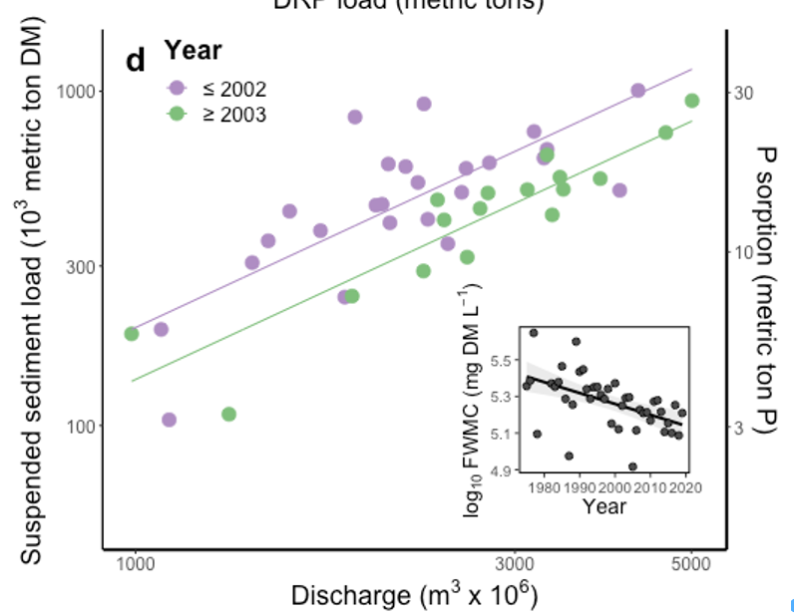

Slide 14
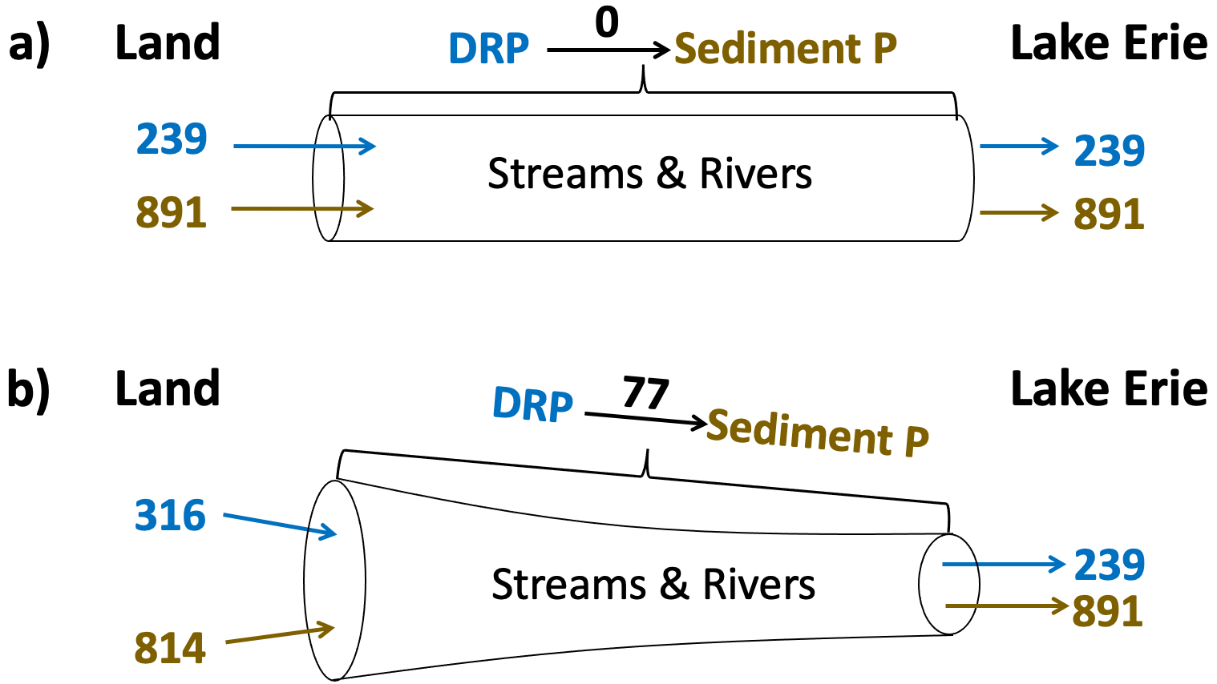

Slide 15
c)

